Slide 1

DO I WATCH THIS MOVIE
STARRING:
Antoine ROGER
Christian BIGONG

Slide 2
TABLE OF CONTENTS
01
02
04
03
COMPANY
PROJECT PRESENTATION
GOALS
GOALS & STRATEGY

Slide 3
PROJECT PRESENTATION
01
You could enter a subtitle here if you need it

Slide 4

ABOUT THE PRODUCT
It's Friday night and you are home and don't know what to watch with your friends? We got you

Slide 5





ABOUT THE PRODUCT
Our product is an online application that allows users, just from a movie title to have the following information on :
CASTING
PLOT
RATINGS
GENRE
POSTER

Slide 6
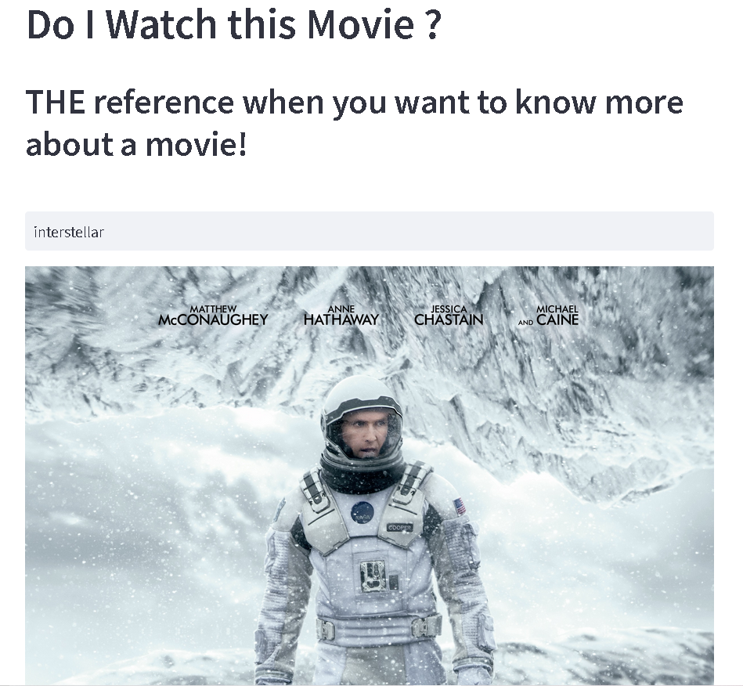
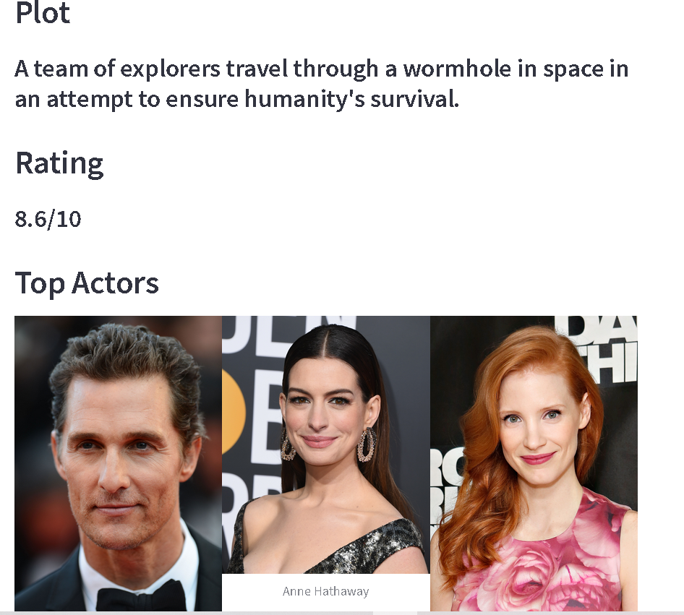
DEMO

Slide 7
OUR COMPANY
02
You could enter a subtitle here if you need it

Slide 8



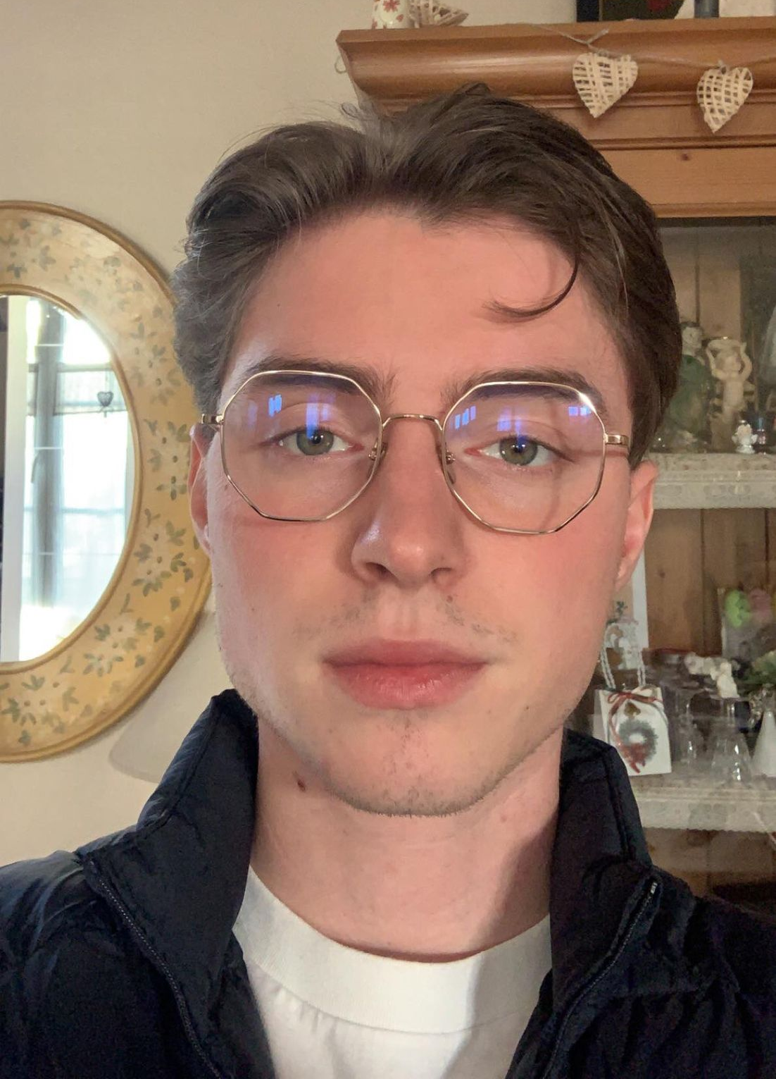
company
TEAM
LOCATION
MONTPELLIER
Christian BIGONG
MARKETING MANAGER
Antoine ROGER
WEB DEV

Slide 9

STRATEGY
03

Slide 10


MARKET STUDY
CUSTOMER
competitors
ALLOCINE
IMDB
MOVIE'S WATCHERS
STREAMING PLATFORM
ANYONE SEEKING FOR AN AD
SUPPLIERS
REGULATION
HOSTINGER(WEB HOST)
GOOGLE(MAIL,ANALYTICS)
CNIL
RGPD

Slide 11


HOW DO WE MAKE MONEY
ADVERTISING
RANKING FOR PLATFORMS
SELLING DATA
For a fee, we will offer other companies to advertise on our website.
When our users search for a film we will offer them platforms where they can find it, and to get their platform first companies will have to pay.
we will enable cookies on our site and sell the information we collect to certain platforms or others. Example: the most searched movie.

Slide 12

BENEFICE SEGMENTATION
65%
25%
10%
advertising
Selling data
RANKINGS

Slide 13
PRICING for ad
$5 day
$20 week
$30 month
BASIC
STANDARD
PREMIUM

Slide 14
PRICING for RANKING
$30 day
$190 WEEK
$650 monthly
BASIC
STANDARD
PREMIUM

Slide 15
THANKS!
Do you have any questions?
Christianmiche.bigong@epfedu.fr
+33 0783996989
https://doiwatchthismovie.streamlit.app/

